Slide 1

StreamFlix Global Viewer Insights
Alexander Brown Anisha Issac Laura Vuong Sreelakshmi Sudey

Slide 2
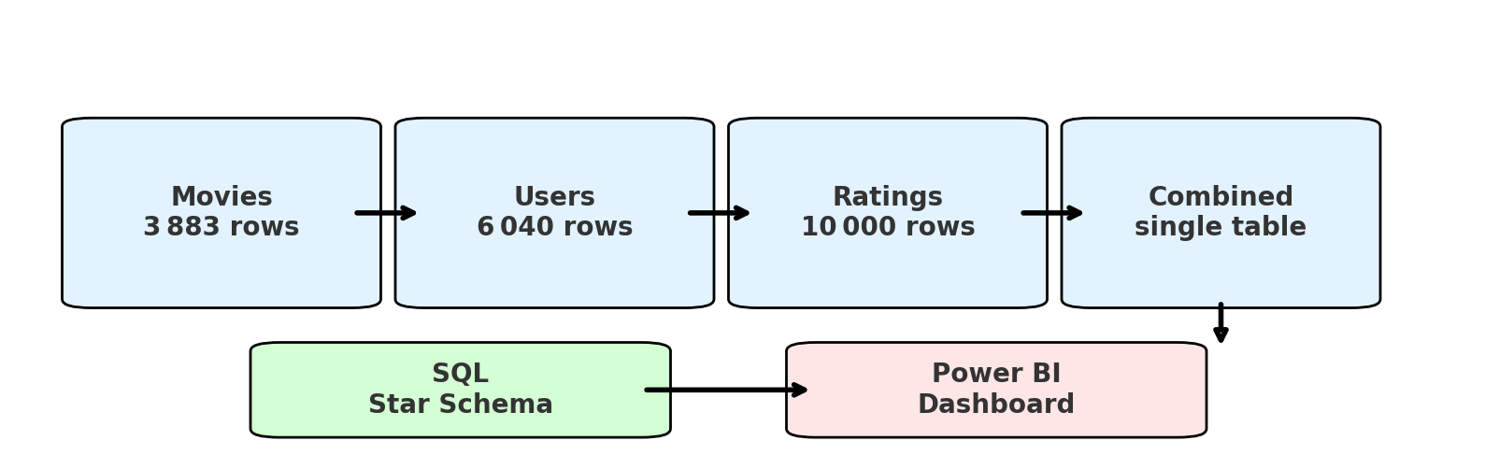
Project Overview
StreamFlix Data Pipeline – 4 Sources → 1 Dashboard

Slide 3
Objectives We Answered
1. Highest-rated movies 2. Most-popular genres 3. Age-group viewing 4. Subscription split 5. Viewer country footprint 6. Device mix Two “bonus” insights: – Genre demand gap – User- Gender- imbalance

Slide 4

Top 10 Movies

Slide 5
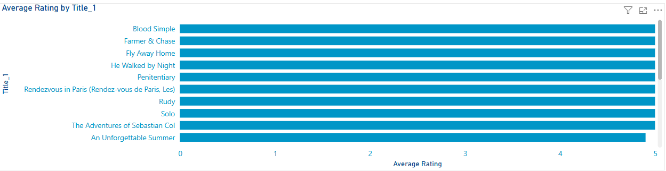

Slide 6
Most Popular Genres

Slide 7
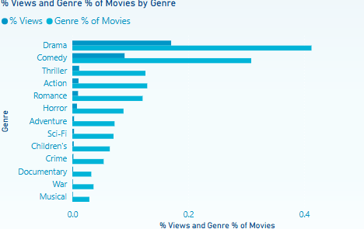
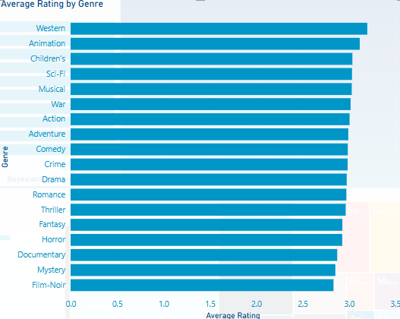

Slide 8
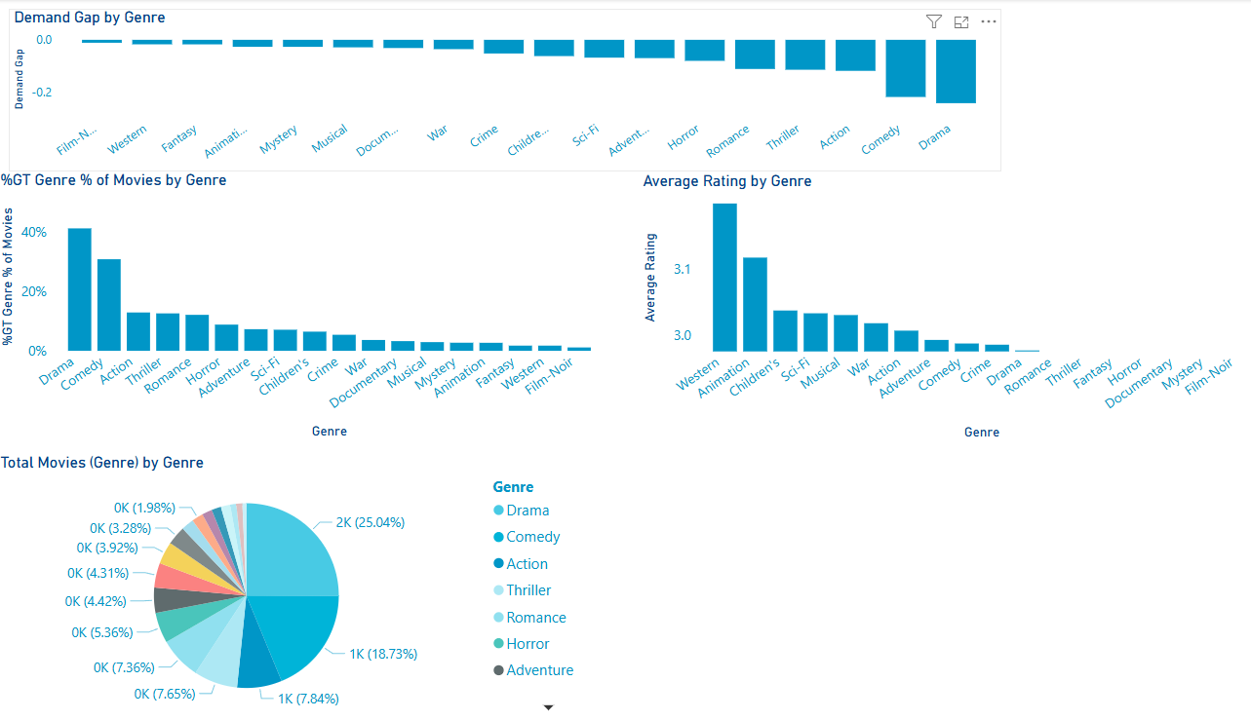

Slide 9
Age Group & Device

Slide 10
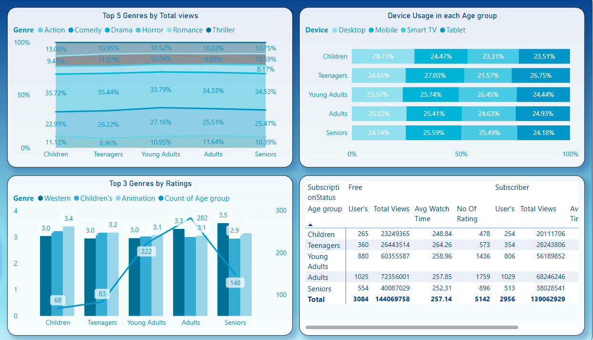
Age Group
Children (<12)

Slide 11
Age Group
Teenagers (13 - 19)

Slide 12
Age Group
Young Adult (20 - 35)

Slide 13
Age Group
Adult (36 - 55)

Slide 14
Age Group
Senior (>55)

Slide 15
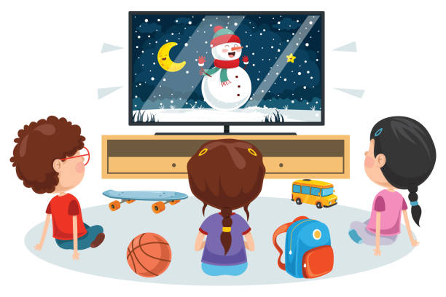




Children
Promote animation content more in the home page and recommendations.
Even though thriller is watched more, animation emotionally resonates better.
Develop a child-friendly desktop interface with parental controls.
Teenagers
Deprioritize action content in their recommendations; focus more on romance and drama.
Optimize mobile/tablet streaming experience (e.g., UI design, quick access).
Recommend binge-worthy series or short-form content formats.
Age Group
Recommendation
Young Adult
Strengthen the library of comedy and drama content.
Consider features that enhance Smart TV user experience like personalized watchlists, shared viewing features, or watch parties.
Highlight trending comedies for this segment.
Adults
They are heavy viewers compared to other age group, so target them by continue investing in drama and action genres.
Target this group with mobile-friendly content and offline viewing options.
Use in-app notifications or personalized suggestions to retain high engagement.
Seniors
Reinforce drama and western genres.
Simplify navigation for mobile and TV users; ensure accessibility (e.g., subtitles, large fonts).
Recommend nostalgic or classic content for emotional engagement.

Slide 16
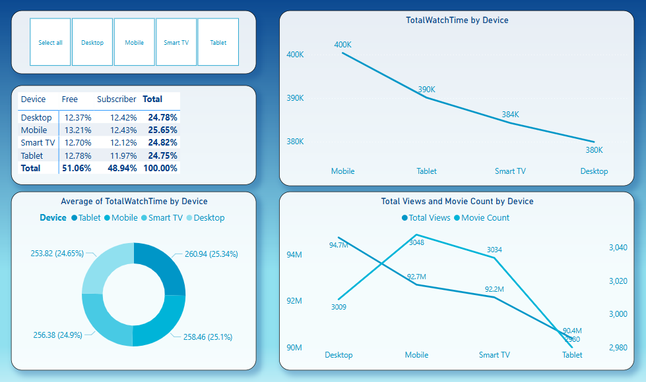
Device - Mobile

Slide 17
Device - Desktop

Slide 18
Device – Smart TV

Slide 19
Device - Tablet

Slide 20


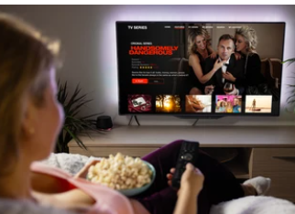
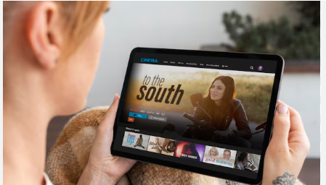

Convert Mobile Viewers with Targeted Offers
Launch mobile-first upgrade campaigns for free users.
Use in-app prompts after binge sessions to suggest Premium.
Highlight mobile perks like offline downloads, ad-free streaming, and early access.
Leverage Desktop Usage for Premium Features
Promote multi-device streaming and premium video quality.
Offer feature comparisons between free vs. paid plans during desktop sessions.
Trigger upgrade prompts after users hit high view thresholds.
Device
Recommendation
Enhance Smart TV Experience for Family Plans
Encourage paid plans with multi-profile access, parental controls, and exclusive content.
Highlight Smart TV benefits during evening/weekend viewing hours.
Boost Tablet Engagement Among Subscribers
Promote long-form or immersive content on tablets (e.g., series, documentaries).
Offer tablet-specific trials o rewards for consistent tablet viewers.
Improve UX and app performance if needed.
Use Personalized Messaging Across Devices
Show upgrade prompts like: “You’ve watched 5+ movies this week – unlock unlimited access!” “Your screen is perfect for Premium HD – Try it now.”

Slide 21
Subscription Status Analysis
Free vs. Subscribed Users

Slide 22
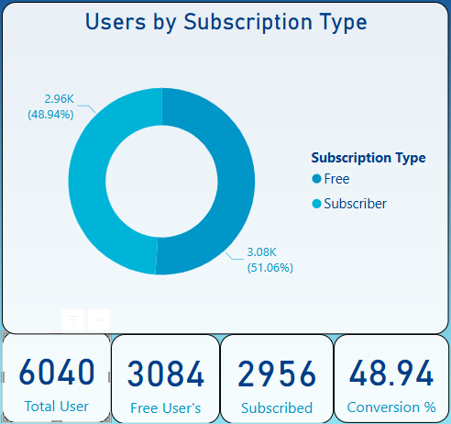
A nearly even split:- opportunity to convert Free users with targeted upsell campaigns.

Slide 23
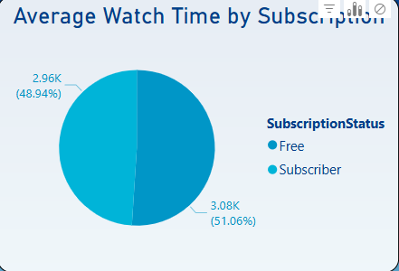
Watch time is almost identical across both groups. Content is engaging even in the free tier.

Slide 24
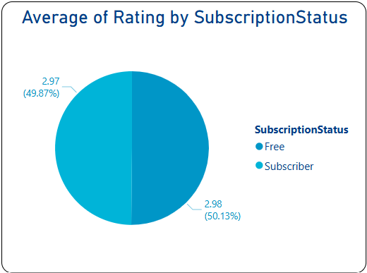
Users rate similarly regardless of subscription. Focus on maintaining quality over pricing.

Slide 25
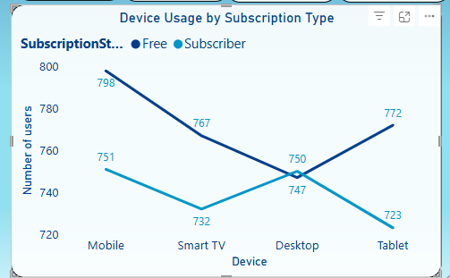
Mobile is the top device among Free users, a smart place to prompt subscription upgrades.

Slide 26
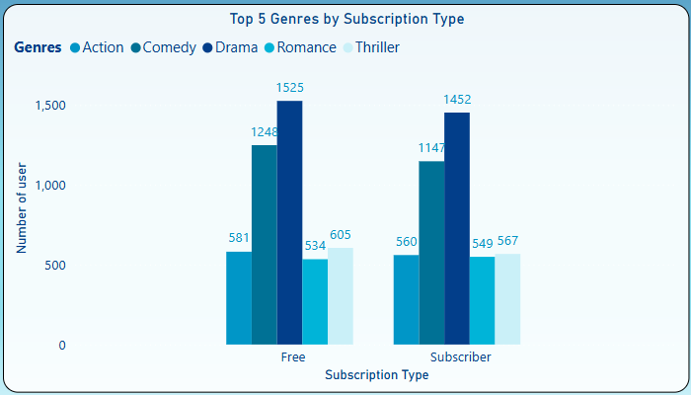
Drama and Comedy lead across both groups. Prioritise these in content and marketing placement.

Slide 27
Recommendations
Focus push notifications on mobile free users with premium previews.
Use Drama & Comedy content to promote subscriptions.
Since watch time and ratings are nearly equal, pricing nudges and exclusive features might convert better than content gating.

Slide 28
Subscription Analysis by Country
Comparing user behaviour and engagement across countries, by Subscription Status.

Slide 29
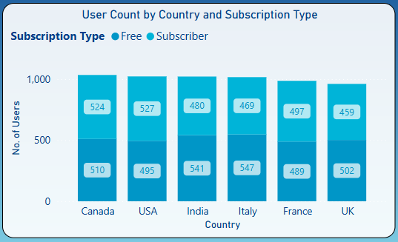
Canada, USA, and India lead in user count. High Free user base in India and Italy signals opportunity for growth.

Slide 30
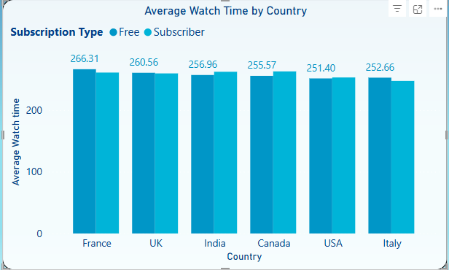
Free users in France show highest watch time. Watch time is fairly consistent across subscription tiers.

Slide 31
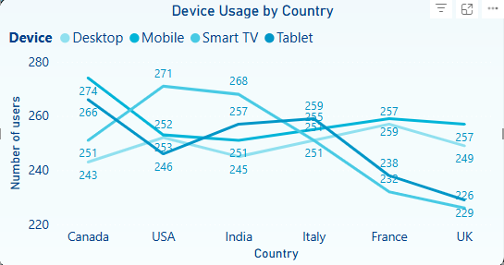
Mobile and tablet dominate across all countries. Tailor subscription prompts to device usage patterns.

Slide 32
Key Insights & Recommendations
Target France for Free-to-Subscriber conversion
Optimise UI for mobile-first countries subscriptions.
Reinforce value in high-subscription regions
Geo-personalised engagement

Slide 33
Opportunity to Scale Movie Streaming Globally
Currently operating in: Canada, USA, UK, France, Italy, India
Existing data shows strong Free user engagement and watch time
Consistent patterns suggest potential in similar international markets

Slide 34
Opportunity to Scale Movie Streaming Globally
Key indicators for global readiness:
High engagement from Free users
Mobile and tablet dominant usage
Diverse viewing preferences across genres
Recommend exploring expansion via:
Pilot programs in new regions
Localised content and language support
Data-driven testing of recommendations and pricing

Slide 35
Bonus Insights

Slide 36
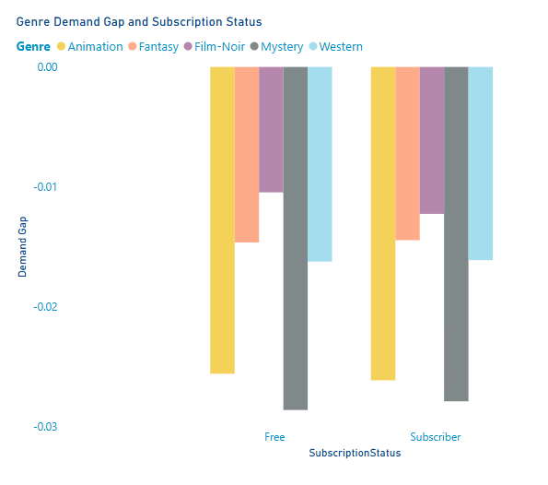
Supply vs Demand by Genre
Gap = % Views – % Catalogue
Action & Sci-Fi +5 pp → under-supplied
Drama & Comedy –8 pp → over-supplied
Free vs Subscriber curves ≈ identical → taste constant across tiers
Male Free gap: Mystery/ Animation Female Free gap: Mystery/ Animation
Priority: license high-gap genres to lift engagement on both tiers

Slide 37
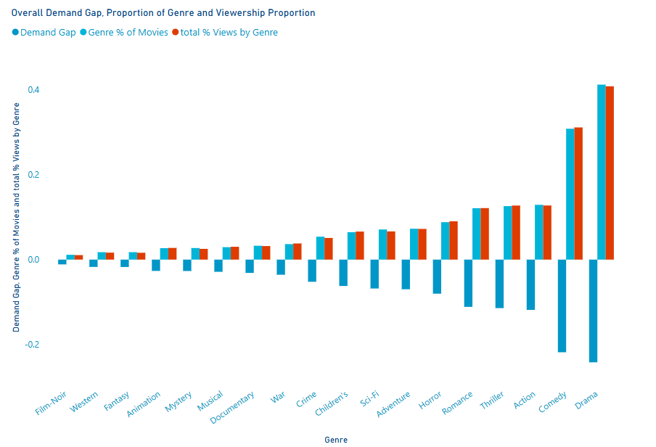

Slide 38
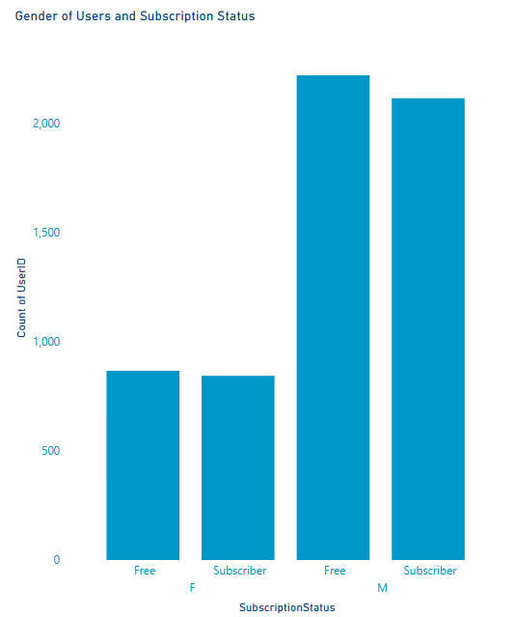
Subscription and Gender Mix
Male : Female ≈ 2 : 1 in both tiers
Subscriber gaps sit near zero (catalogue sufficient)
Upsell idea: gender-targeted banners & trailers in Free tier Paid subscribers of either gender show almost no positive gaps—so catalogue meets their needs.

Slide 39
Key Recommendations

Slide 40
Three Immediate moves
Action | Rationale | Impact
Acquire 20 Action/Sci-Fi titles | Meets +5 pp demand gap | +4 % watch-minutes
Retire least-watched Comedy/Drama | Cuts oversupply cost | save $X licensing
Target Free mobile males with feature-gated upsell | Largest Free cohort | conversion uplift

Slide 41
Known Blockers and Mitigations
Blocker | Impact on current insights | Proposed mitigation / next-data request
Country field is ambiguous (production country, licence territory, or viewer country?) | Territory-level insights risk being misleading | Treat field as production country for now; request separate Viewer-Country in the next extract
No subscription tier or plan-name column (only Free vs Subscriber) | Cannot model ARPU or funnel depth; upsell ideas remain generic | Proceed with binary split; request Tier (Basic / Premium / Ad-supported / Trial) in next drop
Watch-time column is uniform (identical minutes for many users/sessions) | Average-session & device-engagement metrics may be inflated or flat | Flag as data quality issue; need raw session-level watch-time or unique-view duration per user
Ratings table limited to 10 000 entries (subset of 3 883 titles) | Some high-view titles have no rating; skews Top-10 analysis | Request complete ratings dump or clearly mark unrated titles
Genre field inconsistencies fixed manually this sprint | Ongoing manual effort if new data arrives with typos | Agree on genre vocabulary (master list) and automated validation on ingestion
Large combined dataset slows Power BI in DirectQuery | Long refresh time in live demo | Indexed SQL views + Import mode; refresh now 9 s

Slide 42
Questions?
Contact list: Alexei — Scrum Lead Laura — Data Steward Anisha — Power BI Lead Sreelakshmi — Database Architect

Slide 43
Thankyou !!!

